Slide 1
JAVA String class

Slide 2
Constructor
String()
String(“String”)
String(char[] chars)
String s =“hello”;
String s2 =“hello”;
Both points to same location
String objects are Immutable only + operator is overloaded
When we change the string value memory location change

Slide 3
Methods
char charAt(int index)
int compareTo(Object o)
int compareTo(String anotherString)
int compareToIgnoreCase(String str)
String concat(String str)
boolean contentEquals(StringBuffer sb)
boolean equals(Object anObject)
int indexOf(int ch)

Slide 4
Methods
int indexOf(int ch, int fromIndex)
int indexOf(String str)
int lastIndexOf(int ch)
int lastIndexOf(int ch, int fromIndex)
int length()
String replace(char oldChar, char newChar)
String[] split(String regex)
String replaceAll(String regex, String replacement)
Str.replaceAll("(.*)tochange(.*)", “toplace")

Slide 5
Methods
String substring(int beginIndex)
String substring(int beginIndex, int endIndex)
char[] toCharArray()
String toLowerCase()
String toUpperCase()
String trim()

Slide 6
instanceof
class test{
public static void main(String args[]){
demo s=new demo();
System.out.println(s instanceof demo);//true
}
}

Slide 7
Annotations
Java Annotation is a tag that represents the metadata i.e. attached with class, interface, methods or fields to indicate some additional information which can be used by java compiler and JVM.
Annotations in Java are used to provide additional information, so it is an alternative option for XML and Java marker interfaces.

Slide 8
Built-In Java Annotations
Marker Annotations
@Override
@SuppressWarnings
@Deprecated

Slide 9
@Override

Slide 10
class Test{
void showTest(){System.out.println("show method test");}
}
class ChildTest extends Test{
@Override
void showtest(){System.out.println("show method childtest");}//should be Show
}
class TestDemo{
public static void main(String args[]){
ChildTest ct=new ChildTest ();
ct.showTest();
}}
IT will show compile time error as it does not override method

Slide 11
@SuppressWarnings
@SuppressWarnings annotation: is used to suppress warnings issued by the compiler.

Slide 12
import java.util.*;
class TestSuppressWarning{
@SuppressWarnings("unchecked")
public static void main(String args[]){
ArrayList<String> list=new ArrayList<String>();
list.add(“tilak");
list.add(“anil");
list.add(“sunil");
for(Object obj:list)
System.out.println(obj);
}}

Slide 13
@Deprecated
@Deprecated annoation marks that this method is deprecated so compiler prints warning. It informs user that it may be removed in the future versions. So, it is better not to use such methods.

Slide 14
class A{
void m(){System.out.println(“non deprecated funtion");}
@Deprecated
void n(){System.out.println(“deprecated function ");}
}
class TestAnnotation3{
public static void main(String args[]){
A a=new A();
a.n();
}}

Slide 15
Interface
It is collection of abstract method and final static variables.
Methods are by default public
An interface with only one method is called functional interface
An interface with no method is called marker interface.
From java 8 static and default methods are introduced
Static methods - They are declared using the static keyword and will be loaded into the memory along with the interface. You can access static methods using the interface name.
Default Methods - Unlike other abstract methods these are the methods can have a default implementation. If you have default method in an interface, it is not mandatory to override (provide body) it in the classes that are already implementing this interface.

Slide 16
Inner Class & nested class
inner class
Non-static nested classes are known as inner classes s is part of nested class

Slide 17
Advantage
Nested classes represent a special type of relationship that is it can access all the members
Nested classes are used to develop more readable and maintainable code
Code Optimization

Slide 18
Types of Nested classes
Non-static nested class (inner class)
Member inner class
Anonymous inner class
Local inner class
Static nested class

Slide 19
Member Inner Class:- A class created within class and outside method.
Anonymous Inner Class:- A class created for implementing interface or extending class. Its name is decided by the java compiler.
Local Inner Class: A class created within method.
Static Nested Class :- A static class created within class.
Nested Interface An interface created within class or interface.

Slide 20
Anonymous class
A class that have no name is known as anonymous class . It should be used if you have to override method of class or interface. Java Anonymous inner class can be created by two ways:
Class (may be abstract or concrete).
Interface

Slide 21
Using class
abstract class pa{
abstract void eat();
}
class anny1{
public static void main(String args[]){
pa p=new pa(){
void test(){System.out.println("demo anonymus class");}
};
p.test();
}
}

Slide 22
Using interface
interface testing{
void test();
}
class anny2{
public static void main(String args[]){
testing e=new testing(){
public void test(){System.out.println("anyonums class using interface");}
};
e.test();
}
}

Slide 23
Passing as argument
interface result {
int marks();
}
public class asargument {
// method which accepts the object of interface Message
public void displaymarks(result r) {
System.out.println(r.marks() +
", example of anonymous class as an argument");
}
public static void main(String args[]) {
// Instantiating the class
asargument obj = new asargument();
// Passing an anonymous inner class as an argument
obj.displaymarks(new result() {
public int marks() {
return 85;
}
});
}
}

Slide 24
Lambda Expressions
The Lambda expression is used to provide the implementation of functional interface.
It saves a lot of code. In case of lambda expression, we don't need to define the method again for providing the implementation. Here, we just write the implementation code.

Slide 25
Lambda Expression Syntax
(argument-list) -> {body}
Interfacename obj= ()->{ code to be executed};
Interfacename obj= (parameter)->{ code to be executed};
Interfacename obj= (p2,p3)->{ code to be executed};

Slide 26
interface i1
{
void show();
}
class lambdaexp
{
public static void main (String s[])
{
i1 obj =()->{
System.out.println("hello how are you ");
};
obj.show();
}
}

Slide 27
interface i2
{
void show(int a);
}
class lambdaexp2
{
public static void main (String s[])
{
i2 obj =(b)->{
System.out.println("hello how are you "+b);
};
obj.show(10);
}
}

Slide 28
Returning value from lambda expression
interface i3
{ int sum(int a,int b); }
class lambdaexp3
{
public static void main (String s[])
{
i3 obj =(a,b)->{
return (a+b);
};
System.out.println(obj.sum(10,20));
}
}

Slide 29
StringBuffer
Java StringBuffer class is used to create mutable (modifiable) string. The StringBuffer class in java is same as String class except it is mutable

Slide 30
StringBuffer()
StringBuffer(String str)
StringBuffer(int capacity) creates an empty string buffer with the specified capacity as length. Default capacity is 16
When size of stringbuffer is increases it is increased by 2 from older size like old capacity is 16 new size will be 32

Slide 31
append(String s) | is used to append the specified string with this string. The append() method is overloaded like append(char), append(boolean), append(int), append(float), append(double) etc.
insert(int offset, String s) | is used to insert the specified string with this string at the specified position. The insert() method is overloaded like insert(int, char), insert(int, boolean), insert(int, int), insert(int, float), insert(int, double) etc.
replace(int startIndex, int endIndex, String str) | is used to replace the string from specified startIndex and endIndex.
delete(int startIndex, int endIndex) | is used to delete the string from specified startIndex and endIndex.
reverse() | is used to reverse the string.
capacity() | is used to return the current capacity.
ensureCapacity(int minimumCapacity) | It is used to ensure the capacity at least equal to the given minimum.

Slide 32
charAt(int index) | is used to return the character at the specified position.
length() | is used to return the length of the string i.e. total number of characters.
substring(int beginIndex) | is used to return the substring from the specified beginIndex.
substring(int beginIndex, int endIndex) | is used to return the substring from the specified beginIndex and endIndex.

Slide 33
StringBuilder

Slide 34
Difference between stringbuffer and string builder
No. | StringBuffer | StringBuilder
1) | StringBuffer is synchronized i.e. thread safe. It means two threads can't call the methods of StringBuffer simultaneously. | StringBuilder is non-synchronized i.e. not thread safe. It means two threads can call the methods of StringBuilder simultaneously.
2) | StringBuffer is less efficient than StringBuilder. | StringBuilder is more efficient than StringBuffer.

Slide 35
Constructor
Constructor | Description
StringBuilder() | creates an empty string Builder with the initial capacity of 16.
StringBuilder(String str) | creates a string Builder with the specified string.
StringBuilder(int length) | creates an empty string Builder with the specified capacity as length.

Slide 36
Methods of StringBuilder class
Method | Description
public StringBuilder append(String s) | is used to append the specified string with this string. The append() method is overloaded like append(char), append(boolean), append(int), append(float), append(double) etc.
public StringBuilder insert(int offset, String s) | is used to insert the specified string with this string at the specified position. The insert() method is overloaded like insert(int, char), insert(int, boolean), insert(int, int), insert(int, float), insert(int, double) etc.
public StringBuilder replace(int startIndex, int endIndex, String str) | is used to replace the string from specified startIndex and endIndex.
public StringBuilder delete(int startIndex, int endIndex) | is used to delete the string from specified startIndex and endIndex.

Slide 37
public StringBuilder reverse() | is used to reverse the string.
public int capacity() | is used to return the current capacity.
public void ensureCapacity(int minimumCapacity) | is used to ensure the capacity at least equal to the given minimum.
public char charAt(int index) | is used to return the character at the specified position.
public int length() | is used to return the length of the string i.e. total number of characters.
public String substring(int beginIndex) | is used to return the substring from the specified beginIndex.
public String substring(int beginIndex, int endIndex) | is used to return the substring from the specified beginIndex and endIndex.

Slide 38
public class ConcatTest{
public static void main(String[] args){
long startTime = System.currentTimeMillis();
StringBuffer sb = new StringBuffer("Java");
for (int i=0; i<10000; i++){
sb.append("Tpoint");
}
System.out.println("Time taken by StringBuffer: " + (System.currentTimeMillis() - startTime) + "ms");
startTime = System.currentTimeMillis();
StringBuilder sb2 = new StringBuilder("Java");
for (int i=0; i<10000; i++){
sb2.append("Tpoint");
}
System.out.println("Time taken by StringBuilder: " + (System.currentTimeMillis() - startTime) + "ms");
}
}

Slide 39
Exception Handling

Slide 40
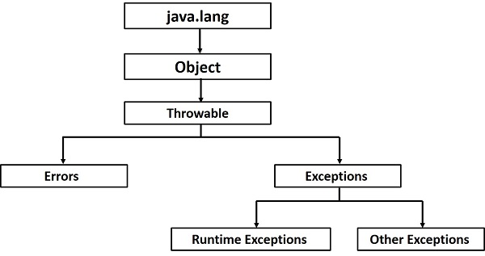

Slide 41
An exception (or exceptional event) is a problem that arises during the execution of a program. When an Exception occurs the normal flow of the program is disrupted and the program/Application terminates abnormally, which is not recommended, therefore, these exceptions are to be handled.
An exception can occur for many different reasons. Following are some scenarios where an exception occurs.
A user has entered an invalid data.
A file that needs to be opened cannot be found.
A network connection has been lost in the middle of communications or the JVM has run out of memory.

Slide 42
Checked exceptions
A checked exception is an exception that is checked (notified) by the compiler at compilation-time, these are also called as compile time exceptions.
Unchecked exceptions
An unchecked exception is an exception that occurs at the time of execution. These are also called as Runtime Exceptions. These include programming bugs, such as logic errors or improper use of an API. Runtime exceptions are ignored at the time of compilation.
Errors
These are not exceptions at all, but problems that arise beyond the control of the user or the programmer. Errors are typically ignored in your code because you can rarely do anything about an error. For example, if a stack overflow occurs, an error will arise. They are also ignored at the time of compilation.

Slide 43
Important Methods
public String getMessage()
Returns a detailed message about the exception that has occurred. This message is initialized in the Throwable constructor.
public Throwable getCause()
Returns the cause of the exception as represented by a Throwable object.
public String toString()
Returns the name of the class concatenated with the result of getMessage().
public void printStackTrace()
Prints the result of toString() along with the stack trace to System.err, the error output stream.

Slide 44
Try, catch and finally
try { // Protected code }
catch (ExceptionName e1) {
// Catch block
}
Finally{
}

Slide 45
Since Java 7, you can handle more than one exception using a single catch block, this feature simplifies the code.
catch (IOException|FileNotFoundException ex) {
}

Slide 46
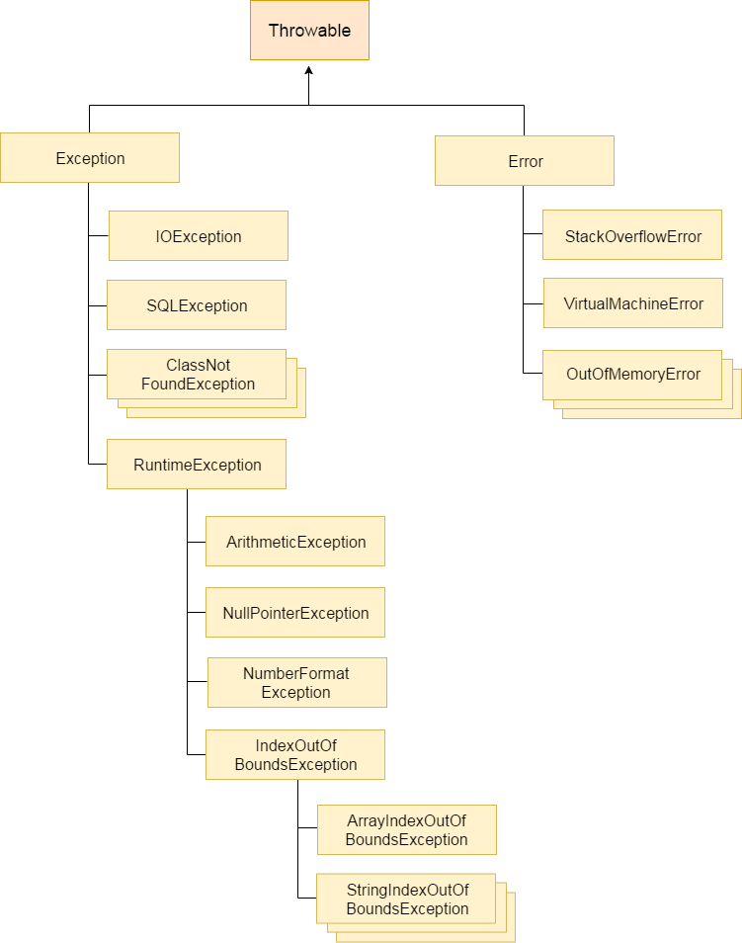

Slide 47
Difference between Error And Exception
Sr. No. | Key | Error | Exception
1 | Type | Classified as an unchecked type | Classified as checked and unchecked
2 | Package | It belongs to java.lang.error | It belongs to java.lang.Exception
3 | Recoverable/ Irrecoverable | It is irrecoverable | It is recoverable
4 |  | It can't be occur at compile time | It can occur at run time compile time both
5 | Example | OutOfMemoryError ,IOError | NullPointerException , SqlException

Slide 48
ExceptionHandling with MethodOverriding
If the superclass method does not declare an exception
If the superclass method does not declare an exception, subclass overridden method cannot declare the checked exception but it can declare unchecked exception.
If the superclass method declares an exception
If the superclass method declares an exception, subclass overridden method can declare same, subclass exception or no exception but cannot declare parent exception.

Slide 49
import java.io.*;
class Parent{
void msg(){System.out.println("parent");}
}
class TestExceptionChild extends Parent{
void msg()throws IOException{
System.out.println("Child");
}
public static void main(String args[]){
Parent p=new TestExceptionChild();
p.msg();
}
}
Compile time error

Slide 50
import java.io.*;
class Parent{
void msg(){System.out.println("parent");}
}
class TestExceptionChild1 extends Parent{
void msg()throws ArithmeticException{
System.out.println("child");
}
public static void main(String args[]){
Parent p=new TestExceptionChild1();
p.msg();
}
}
Output child

Slide 51
If the superclass method declares an exception
1) Rule: If the superclass method declares an exception, subclass overridden method can declare same, subclass exception or no exception but cannot declare parent exception.

Slide 52
import java.io.*;
class Parent{
void msg()throws ArithmeticException{System.out.println("parent");}
}
class TestExceptionChild2 extends Parent{
void msg()throws Exception{System.out.println("child");}
public static void main(String args[]){
Parent p=new TestExceptionChild2();
try{
p.msg();
}catch(Exception e){}
}
}

Slide 53
Subclass overridden method declares same exception
import java.io.*;
class Parent{
void msg()throws Exception{System.out.println("parent");}
}
class TestExceptionChild3 extends Parent{
void msg()throws Exception{System.out.println("child");}
public static void main(String args[]){
Parent p=new TestExceptionChild3();
try{
p.msg();
}catch(Exception e){}
}
}

Slide 54
subclass overridden method declares subclass exception
import java.io.*;
class Parent{
void msg()throws Exception{System.out.println("parent");}
}
class TestExceptionChild4 extends Parent{
void msg()throws ArithmeticException{System.out.println("child");}
public static void main(String args[]){
Parent p=new TestExceptionChild4();
try{
p.msg();
}catch(Exception e){}
}
}

Slide 55
subclass overridden method declares no exception
import java.io.*;
class Parent{
void msg()throws Exception{System.out.println("parent");}
}
class TestExceptionChild5 extends Parent{
void msg(){System.out.println("child");}
public static void main(String args[]){
Parent p=new TestExceptionChild5();
try{
p.msg();
}catch(Exception e){}
}
}

Slide 56
Creating own Exception class
In java we can create own exception by extending exception class
We need to call super class constructor in order to set error message

Slide 57
class myexcep extends Exception{
myexcep (String s){ super(s);
}
}
class myexceptiondemo
{
void testexp(int a) throws myexcep
{
if(a<0)
throw new myexcep("This is test of my exception");
}
public static void main(String s[])
{
myexceptiondemo obj=new myexceptiondemo();
try{
obj.testexp(-5);
}
catch (myexcep me)
{
me.printStackTrace();
}
}
}

Slide 58
Method Reference
There are following types of method references in java:
Reference to a static method.
Reference to an instance method.
Reference to a constructor.
Java provides a new feature called method reference in Java 8. Method reference is used to refer method of functional interface. It is compact and easy form of lambda expression. Each time when you are using lambda expression to just referring a method, you can replace your lambda expression with method reference

Slide 59
Reference to an Instance Method
interface imr2{
void test();
}
public class MR2 {
public void show(){
System.out.println("Hello, this is non-static method.");
}
public static void main(String[] args) {
MR2 obj = new MR2(); // Creating object
// Referring non-static method using reference
imr2 obji2 = obj::show;
// Calling interface method
obji2.test();
// Referring non-static method using anonymous object
imr2 obji21 = new MR2()::show; // You can use anonymous object also
// Calling interface method
obji21.test();
}
}

Slide 60
Reference to a Static Method
interface is1{
void test();
}
public class MR1 {
public static void show(){
System.out.println("Hello, this is static method.");
}
public static void main(String[] args) {
// Referring static method
is1 obj = MR1::show;
// Calling interface method
obj.test();
}
}

Slide 61
Reference to a Constructor
//constructor reference
interface im{
MR3MSG getMessage(String msg);
}
class MR3MSG{
MR3MSG(String msg){
System.out.print(msg);
}
}
public class conref {
public static void main(String[] args) {
im obj = MR3MSG::new;
obj.getMessage("Hello");
}
}

Slide 62
Object Class

Slide 63
S.NO | Method | Description
1 | public final Class getClass() | returns the Class class object of this object. The Class class can further be used to get the metadata of this class.
2 | public int hashCode() | returns the hashcode number for this object.
3 | public boolean equals(Object obj) | compares the given object to this object.
4 | protected Object clone() throws CloneNotSupportedException | creates and returns the exact copy (clone) of this object.
5 | public String toString() | returns the string representation of this object.
6 | protected void finalize()throws Throwable | is invoked by the garbage collector before object is being garbage collected.

Slide 64
Protected void finalize
public class JFE {
int i=1;
public static void main(String[] args)
{
JFE obj = new JFE();
System.out.println(obj.hashCode());
obj = null;
// calling garbage collector
System.gc();
{
JFE obj2 = new JFE();
System.out.println(obj2.hashCode());
obj2 = null;
}
// calling garbage collector
System.gc();
System.out.println("end of garbage collection");
}
@Override
protected void finalize()
{ i++;
System.out.println("finalize method called"+i);
}
}

Slide 65
Cloning of object
The object cloning is a way to create exact copy of an object. The clone() method of Object class is used to clone an object.
The java.lang.Cloneable interface must be implemented by the class whose object clone we want to create. If we don't implement Cloneable interface, clone() method generates CloneNotSupportedException. Cloneable interface is a marker interface with no method in it.
The clone() method is defined in the Object class.
protected Object clone() throws CloneNotSupportedException

Slide 66
class emp implements Cloneable{
int empid;
String ename;
emp(int empid,String ename){
this.empid=empid;
this.ename=ename;
}
public Object clone()throws CloneNotSupportedException{
return super.clone();
}
public static void main(String args[]){
try{
emp e1=new emp(101,"sunil");
emp e2=(emp)e1.clone();
System.out.println(e1.rollno+" "+e1.ename+e1.hashCode());
System.out.println(e2.rollno+" "+e2.ename+e2.hashCode());
}catch(CloneNotSupportedException c){}
}
}

Slide 67
Equals method
class testequals{
public static void main(String[] args){
String a = "sunil";
String b = "sunil";
if(a.equals(b)){
System.out.println("a & b are equal variables, and their respective hashvalues are:" + " "+ a.hashCode() + " & " + b.hashCode());
}
String c = "ajay";
String d= "vijay";
if(!c.equals(d)){
System.out.println("\nc & d are Un-equal variables, and their respective hashvalues are:" + " "+ c.hashCode() + " & " + d.hashCode());
}
}
}

Slide 68
Runtime Class
No. | Method | Description
1) | public static Runtime getRuntime() | returns the instance of Runtime class.
2) | public void exit(int status) | terminates the current virtual machine.
3) | public void addShutdownHook(Thread hook) | registers new hook thread.
4) | public Process exec(String command)throws IOException | executes given command in a separate process.
5) | public int availableProcessors() | returns no. of available processors.
6) | public long freeMemory() | returns amount of free memory in JVM.
7) | public long totalMemory() | returns amount of total memory in JVM.

Slide 69
public class Runtime1{
public static void main(String args[])throws Exception{
Runtime.getRuntime().exec("notepad");//will open a new notepad
}
}

Slide 70
Shutdown system in java
public class Runtime2{
public static void main(String args[])throws Exception{
Runtime.getRuntime().exec("shutdown -s -t 0");
/*Runtime.getRuntime().exec("c:\\Windows\\System32\\shutdown -s -t 0"); // for windows */
}
}

Slide 71
Java Runtime availableProcessors()
public class Runtime4{
public static void main(String args[])throws Exception{
System.out.println(Runtime.getRuntime().availableProcessors());
}
}

Slide 72
Runtime freeMemory() and totalMemory() method
public class MemoryTest{
public static void main(String args[])throws Exception{
Runtime r=Runtime.getRuntime();
System.out.println("Total Memory: "+r.totalMemory());
System.out.println("Free Memory: "+r.freeMemory());
for(int i=0;i<10000;i++){
new MemoryTest();
}
System.out.println("After creating 10000 instance, Free Memory: "+r.freeMemory());
System.gc();
System.out.println("After gc(), Free Memory: "+r.freeMemory());
}
}

Slide 73
JAVA IO STREAM
SOURCE
PROG
DESTINATION

Slide 74
InPutStream − The InputStream is used to read data from a source.
OutPutStream − The OutputStream is used for writing data to a destination.

Slide 75
BYTE STREAM
byte streams are used to perform input and output of 8-bit bytes.
FileInputStream and FileOutputStream are most frequently used byte stream classes
FileInputStream use to read data and FileOutputStream use to write data

Slide 76
FileOutputStream methods
public class FileOutputStream extends OutputStream
protected void finalize()
void write(byte[] ary)
void write(int b)
void close()

Slide 77
FileInputStream methods
public class FileInputStream extends InputStream
int available() | It is used to return the estimated number of bytes that can be read from the input stream.
int read() | It is used to read the byte of data from the input stream.
int read(byte[] b) | It is used to read up to b.length bytes of data from the input stream.
long skip(long x) | It is used to skip over and discards x bytes of data from the input stream.
protected void finalize() | void close()

Slide 78
import java.io.*;
public class CopyFile {
public static void main(String args[]) throws IOException {
FileInputStream in = null;
FileOutputStream out = null;
try {
in = new FileInputStream("input.txt");
out = new FileOutputStream("output.txt");
int c;
while ((c = in.read()) != -1) {
out.write(c);
}
}finally {
if (in != null) {
in.close();
}
if (out != null) {
out.close();
}
}
}
}

Slide 79
FileReader
public class FileReader extends InputStreamReader
FileReader(String file)
FileReader(File file)
int read()-It is used to return a character in ASCII form. It returns -1 at the end of file.
void close()-It is used to close the FileReader class.

Slide 80
import java.io.FileReader;
public class fileread {
public static void main(String args[])throws Exception{
FileReader fr=new FileReader(“mytext.text");
int i;
while((i=fr.read())!=-1)
System.out.print((char)i);
fr.close();
}
}

Slide 81
FileWriter
public class FileWriter extends OutputStreamWriter
FileWriter(String file)
FileWriter(File file)
void write(String text)- It is used to write the string into FileWriter.
void write(char c)-It is used to write the char into FileWriter.
void write(char[] c)-It is used to write char array into FileWriter.
void flush() --It is used to flushes the data of FileWriter.
void close()--It is used to close the FileWriter.

Slide 82
import java.io.FileWriter;
public class fwr{
public static void main(String args[]){
try{
FileWriter fw=new FileWriter(“my.txt");
fw.write("Welcome to universal informatics.");
Fw.flush();
fw.close();
}catch(Exception e){System.out.println(e);}
System.out.println("Success...");
}
}

Slide 83
BufferedInputStream
public class BufferedInputStream extends FilterInputStream
BufferedInputStream(InputStream IS)
BufferedInputStream(InputStream IS, int buffersize)

Slide 84
int available() | It returns an estimate number of bytes that can be read from the input stream without blocking by the next invocation method for the input stream.
int read() | It read the next byte of data from the input stream.
int read(byte[] b, int off, int ln) | It read the bytes from the specified byte-input stream into a specified byte array, starting with the given offset.
void close() | It closes the input stream and releases any of the system resources associated with the stream.
void reset() | It repositions the stream at a position the mark method was last called on this input stream.
void mark(int readlimit) | It sees the general contract of the mark method for the input stream.
long skip(long x) | It skips over and discards x bytes of data from the input stream.
boolean markSupported() | It tests for the input stream to support the mark and reset methods.

Slide 85
import java.io.*;
public class BufferedInputStreamExample{
public static void main(String args[]){
try{
FileInputStream fin=new FileInputStream(“test.txt");
BufferedInputStream bin=new BufferedInputStream(fin);
int i;
while((i=bin.read())!=-1){
System.out.print((char)i);
}
bin.close();
fin.close();
}catch(Exception e){System.out.println(e);}
}
}

Slide 86
BufferedOutputStream
public class BufferedOutputStream extends FilterOutputStream
BufferedOutputStream(OutputStream os)
BufferedOutputStream(OutputStream os, int buffersize)
void write(int b) | It writes the specified byte to the buffered output stream.
void write(byte[] b, int off, int len) | It write the bytes from the specified byte-input stream into a specified byte array, starting with the given offset
void flush() | It flushes the buffered output stream.

Slide 87
import java.io.*;
public class BufferedOutputStreamExample{
public static void main(String args[])throws Exception{
FileOutputStream fout=new FileOutputStream(“test.txt");
BufferedOutputStream bout=new BufferedOutputStream(fout);
String s="Welcome to the class of java.";
byte b[]=s.getBytes();
bout.write(b);
bout.flush();
bout.close();
fout.close();
System.out.println("success");
} }

Slide 88
Serialization and Deserialization
To serialize an object means to convert its state to a byte stream so that the byte stream can be reverted back into a copy of the object. A Java object is serializable if its class or any of its superclasses implements either the java. io. Serializable interface or its subinterface,
java.io.Externalizable. Deserialization is the process of converting the serialized form of an object back into a copy of the object.

Slide 89
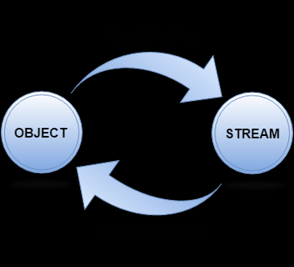

Slide 90
ObjectOutputStream
public ObjectOutputStream(OutputStream out) throws IOException {}
Method | Description
1) public final void writeObject(Object obj) throws IOException {} | writes the specified object to the ObjectOutputStream.
2) public void flush() throws IOException {} | flushes the current output stream.
3) public void close() throws IOException {} | closes the current output stream.

Slide 91
ObjectInputStream
public ObjectInputStream(InputStream in) throws IOException {}
Method | Description
1) public final Object readObject() throws IOException, ClassNotFoundException{} | reads an object from the input stream.
2) public void close() throws IOException {} | closes ObjectInputStream.

Slide 92
Employee class
import java.io.Serializable;
public class emp implements Serializable{
int eid;
String ename;
public emp(int eid, String ename) {
this.eid = id;
this.ename = name;
}
}

Slide 93
import java.io.*;
class empSerialize{
public static void main(String args[]){
try{
//Creating the object
emp s1 =new emp(101,"anil kumar");
//Creating stream and writing the object
FileOutputStream fout=new FileOutputStream("e.txt");
ObjectOutputStream out=new ObjectOutputStream(fout);
out.writeObject(s1);
out.flush();
//closing the stream
out.close();
System.out.println("success");
}catch(Exception e){System.out.println(e);}
}
}

Slide 94
import java.io.*;
class Deserialize{
public static void main(String args[]){
try{
//Creating stream to read the object
ObjectInputStream in=new ObjectInputStream(new FileInputStream("e.txt"));
emp e=(emp)in.readObject();
//printing the data of the serialized object
System.out.println(e.eid+" "+e.ename);
//closing the stream
in.close();
}catch(Exception e){System.out.println(e);}
}
}

Slide 95
Multithreading
Multithreading in Java is a process of executing multiple threads simultaneously.
A thread is a lightweight sub-process, the smallest unit of processing. Multiprocessing and multithreading, both are used to achieve multitasking

Slide 96
Advantages
1) It doesn't block the user because threads are independent and you can perform multiple operations at the same time.
2) You can perform many operations together, so it saves time.
3) Threads are independent, so it doesn't affect other threads if an exception occurs in a single thread.

Slide 97
Life cycle of thread
Start
Start()
Sleep done, i/o complete lock gain , notify(), notifyAll ()
Runnable
Non runnable/ blocked
Running
Sleep, block on i/o wait for lock , suspend() , wait()
Run mehtod end or exits
Terminated

Slide 98
Methods
S.No | Methods | Description
1 | Void join | It is used to start the execution of the thread.
2 | Void run | It is used to do an action for a thread.
3 | Void sleep(miliseconds | It is use to sleep the thread for a given time
4 | static Thread currentThread() | It returns a reference to the currently executing thread object.
5 | Void join | It waits for a thread to die.
6 | getPriority() and setPriority | To get and set the priority for the thread Default priority is 5, 1 is minimum and 10 is maximum
7 | getName() and setName() | To get and set name of thread

Slide 99
Methods
S.No | Methods | Description
8 | Long getId() | It is used to get id of current thread
9 | Boolean isAlive() | It stests if the thread is alive.
10 | Static void yield() | It causes the currently executing thread object to pause and allow other threads to execute temporarily.
11 | Void suspend() | It is used to suspend the thread.
12 | Void resume() | It is used to resume the suspended thread.
13 | Void stop () | It is used to stop the thread.
14 | boolean isDaemon() | It tests if the thread is a daemon thread.

Slide 100
Methods
S.No | Methods | Description
15 | setDaemon() | It marks the thread as daemon or user thread.
16 | Boolean isAlive() | It stests if the thread is alive.
17 | Static void yield() | It causes the currently executing thread object to pause and allow other threads to execute temporarily.
18 | Void suspend() | It is used to suspend the thread.
19 | Void resume() | It is used to resume the suspended thread.
20 | Void stop () | It is used to stop the thread.
21 | boolean isDaemon() | It tests if the thread is a daemon thread.

Slide 101
To create thread
By extending Thread class
By implementing Runnable interface.
Commonly used Constructors of Thread class:
Thread()
Thread(String name)
Thread(Runnable r)
Thread(Runnable r,String name)
Runnable interface:
public void run(): is used to perform action for a thread.

Slide 102
class Multi extends Thread{
public void run(){
System.out.println("thread is running...");
}
public static void main(String args[]){
Multi t1=new Multi();
t1.start();
}
}

Slide 103
class Multi3 implements Runnable{
public void run(){
System.out.println("thread is running...");
}
public static void main(String args[]){
Multi3 m1=new Multi3();
Thread t1 =new Thread(m1);
t1.start();
}
}

Slide 104
Isalive
public class classisalive extends Thread
{
public void run()
{
try
{
sleep(300);
System.out.println("method called");
}
catch (InterruptedException ie) {
}
}
public static void main(String[] args)
{
classisalive t1 = new classisalive();
System.out.println("before starting thread isAlive: "+t1.isAlive());
t1.start();
System.out.println("after starting thread isAlive: "+t1.isAlive());
}
}

Slide 105
Join and sleep
class Ts1alive extends Thread
{
public void run()
{
int i=1;
while(true)
{
System.out.print("odd "+i);
i+=2;
try{
sleep(2000);
}
catch (InterruptedException ie)
{
ie.printStackTrace();
}
}
}
}

Slide 106
class Ts2alive extends Thread
{
public void run()
{
int i=2;
while(true)
{
System.out.print("even "+i);
i+=2;
try{
sleep(2000);
}
catch (InterruptedException ie)
{
ie.printStackTrace();
}
}
}
}

Slide 107
class threadTs1Ts2alive
{
public static void main(String s[])
{
Ts1alive obj= new Ts1alive();
Ts2alive obj2= new Ts2alive();
obj.start();
try{
obj.join();
}
catch(InterruptedException ie)
{
ie.printStackTrace();
}
obj2.start();
}
}

Slide 108
Priority of a Thread
3 constants defined in Thread class:
public static int MIN_PRIORITY
public static int NORM_PRIORITY
public static int MAX_PRIORITY

Slide 109
Priority
class threadTs1Ts2Priority
{
public static void main(String s[])
{
Ts1alivep obj= new Ts1alivep();
Ts2alivep obj2= new Ts2alivep();
obj.setPriority(10);
obj2.setPriority(2);
obj.start();
obj2.start();
}
}

Slide 110
setDaemon(true)
public class threadDaemon extends Thread
{
public void run()
{
//checking for daemon thread
if(Thread.currentThread().isDaemon())
{
System.out.println("daemon thread work");
}
else
{
System.out.println("user thread work");
}
}

Slide 111
public static void main(String[] args)
{
threadDaemon t1=new threadDaemon();
threadDaemon t2=new threadDaemon();
threadDaemon t3=new threadDaemon();
threadDaemon t4=new threadDaemon();
// set user thread t1 to daemon thread
t1.setDaemon(true);
//starting all the threads
t1.start();
t2.start();
t3.start();
t4.start();
}
}

Slide 112
Thread Synchronization
There are two types of thread synchronization
Mutual Exclusive
Synchronized method.
Synchronized block.
static synchronization.
Cooperation (Inter-thread communication in java)

Slide 113
Mutual Exclusive
by synchronized method
by synchronized block
by static synchronization

Slide 114
What will happen when two or more than two thread access same resource

Slide 115
When two thread access same resource and it is unsynchronized communication is leads to deadlock in thread. To solve this we use synchronized method or block in order to prevent the deadlock

Slide 116
synchronized block
Synchronized block can be used to perform synchronization on any specific resource of the method.
Synchronized block is used to lock an object for any shared resource.
Scope of synchronized block is smaller than the method.

Slide 117
Static synchronized method

Slide 118
Deadlock
Thread 2
Thread 1

Slide 119
Inter thread communication
Inter-thread communication is all about allowing synchronized threads to communicate with each other.
We are having three methods from object class
wait()
notify()
notifyAll()

Slide 120
AWT

Slide 121
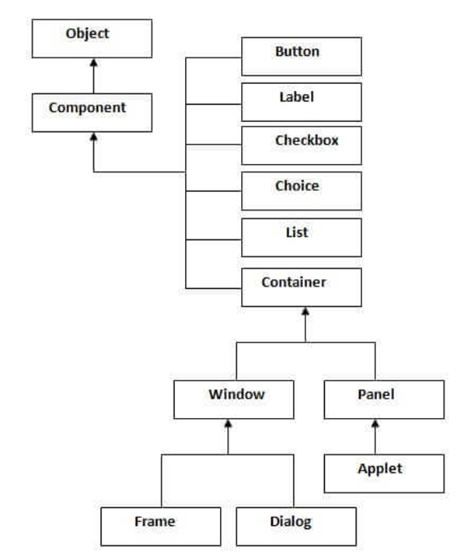

Slide 122
Layout Manager
java.awt.BorderLayout
java.awt.FlowLayout
java.awt.GridLayout
java.awt.CardLayout
java.awt.GridBagLayout
javax.swing.BoxLayout
javax.swing.GroupLayout
javax.swing.ScrollPaneLayout
javax.swing.SpringLayout etc.

Slide 123
Event classes and Listener interfaces
Event Classes | Listener Interfaces
ActionEvent | ActionListener
MouseEvent | MouseListener and MouseMotionListener
MouseWheelEvent | MouseWheelListener
KeyEvent | KeyListener
ItemEvent | ItemListener
TextEvent | TextListener
AdjustmentEvent | AdjustmentListener
WindowEvent | WindowListener
ComponentEvent | ComponentListener
ContainerEvent | ContainerListener
FocusEvent | FocusListener

Slide 124
Java 9 features
Private method in interface
Try with resources
Jshell

Slide 125
interface IPri{
default void test() {
pri_m1(); // call to private method
pri_static_m2(); // call to private static method
}
// Private method inside interface
private void pri_m1() {
System.out.println("Hello... I'm private method");
}
// Private static method inside interface
private static void pri_static_m2() {
System.out.println("I'm private static method");
}
}
public class ClassIPri implements IPri {
public static void main(String[] args) {
IPri obj = new ClassIPri();
obj.test();
}
} s

Slide 126
Try with resource
When it come to close the stream outside the try we always need to call the close method.
But with this feature we need not to call close method outside or inside try, but as try ends it closes the resource for us.
In java 7 we need to declare the resource with try block like try(FileOutPutStream fobj= new FileOutputStream(“filename”);
But in java 9 we can pass object of stream in try

Slide 127
import java.io.FileNotFoundException;
import java.io.FileOutputStream;
public class FinalVariable {
public static void main(String[] args) throws FileNotFoundException {
try(FileOutputStream fileStream=new FileOutputStream(“data.txt");){
String greeting = "Welcome to class .";
byte b[] = greeting.getBytes();
fileStream.write(b);
System.out.println("File written");
}catch(Exception e) {
System.out.println(e);
}
}
}

Slide 128
Jshell
It is an interactive Java Shell tool, it allows us to execute Java code from the shell and shows output immediately. JShell is a REPL (Read Evaluate Print Loop) tool and run from the command line
We can directly write code to execute and assign variables in jshell
How to start Jshell
We need to start terminal(linux) or command prompt(window ) now type jshell –v

Slide 129
Jshell command
To print use System.out.println(“MSG here”);
To declare variable int a=10; (semicolon is optional either use or leave it)
Scratch Variables : when we don’t give any name to a variable scratch variable is created which start with $.
> 20
$3=>20 . $3 is scratch variable.
System.out.println($3);
Expression
>2+3
>2+(5*4+(2+1))

Slide 130
Jshell> void show(() {
System.out.println(“demo method”);
}
Jshell> show();
Creating class in jshell
> class test
{
Void show()
{
System.out.println(“This is class method”);
}
}
>new test().show();

Slide 131
Import package in jshell
We can import packages directly in jshell to use them in our code
Import java.util.*;
By default 10 packages are already imported in jshell and more we can import
To see, default import packages, we can use following command.
> /import

Slide 132
Command /vars to show variables that we have created so far
To get all written source code, use /list

Slide 133
Module in java 9
Module is a collection of Java programs or softwares. To describe a module, a Java file module-info.java is required. This file also known as module descriptor and defines the following
Module name
What does it export
What does it require

Slide 134
To create Java module
Creating Java module required the following steps.
Create a directory structure
Create a module declarator
Java source code

Slide 135
Create a file module-info.java, inside this file, declare a module by using module identifier and provide module name same as the directory name that contains it. In our case, our directory name is com.java6pm
module com.java6pm{
}
. Leave module body empty, if it does not has any module dependency. Save this file inside src/com.java6pm with module-info.java name.

Slide 136
Source Code
Now we create a file with following code
class Hello{
public static void main(String[] args){
System.out.println("Hello from the Java module");
}
}

Slide 137
Compile Java Module
javac -d mods --module-source-path src/ --module com.java6pm
Run Module
java --module-path mods/ --module com.java6pm/com.java6pm.Hello

Slide 138
Java 10 features
Local Variable Type Inference
Java has now var style declarations. It allows you to declare a local variable without specifying its type. The type of variable will be inferred from type of actual object created. It claims to be the only real feature for developers in JDK 10.
Time-Based Release Versioning
Starting from Java 10, Oracle has adapted time based version-string scheme. The new format of the version number is:
$FEATURE.$INTERIM.$UPDATE.$PATCH

Slide 139
Garbage-Collector Interface
Parallel Full GC for G1
Java 9 introduced G1 (garbage first) garbage collector. The G1 garbage collector is designed to avoid full collections, but when the concurrent collections can’t reclaim memory fast enough. With this change, a fall back full GC will occur.
The current implementation of the full GC for G1 uses a single threaded mark-sweep-compact algorithm. This change will parallelize the mark-sweep-compact algorithm and use the same number of threads. It will be triggered when concurrent threads for collection can’t revive the memory fast enough.
The number of threads can be controlled by the -XX:ParallelGCThreads option

Slide 140
Heap Allocation on Alternative Memory Devices
The goal of this change is to enable the HotSpot VM to allocate the Java object heap on an alternative memory device, such as an NV-DIMM, specified by the user.
Nvdimm- A non-volatile dual in-line memory module (NVDIMM) is a type of random-access memory for computers.
Consolidate the JDK Forest into a Single Repository
In JDK 9 there are eight repos: root, corba, hotspot, jaxp, jaxws, jdk, langtools, and nashorn
today in the JDK forest there are module-based directories like

Slide 141
$ROOT/jdk/src/java.base ... $ROOT/langtools/src/java.compiler
But in jdk 10
$ROOT/src/java.base
$ROOT/src/java.compiler
Application Class-Data Sharing
The goal of this feature is to improve the startup footprint, extends the existing Class-Data Sharing (“CDS”) feature to allow application classes to be placed in the shared archive.
Additional Unicode Language-Tag Extensions
t’s goal is to enhance java.util.Locale and related APIs to implement additional Unicode extensions of BCP 47

